Slide 1
Operating Systems
Chapter 4 Threads, SMP, and Microkernels

Slide 2
Agenda
4.1 Processes and Threads
4.2 Symmetric Multiprocessing
4.3 Microkernel
4.4 Summary

Slide 3
4.1 Processes and Threads
4.1.1 Introduction
4.1.2 Multithreading
4.1.3 Thread Functionality
4.1.4 User-Level and Kernel-Level Thread
4.1.5 Other Arrangements

Slide 4
Introduction
Resource ownership(资源所有权) - process includes a virtual address space to hold the process image
Scheduling/execution(调度/执行)- follows an execution path that may be interleaved with other processes
These two characteristics are treated independently by the operating system
Notes:
独立处理treated independently

Slide 5
Introduction
Dispatching is referred to as a thread or lightweight process(调度的单位称为线程或轻量进程)
Resource of ownership is referred to as a process or task(资源所有权的单位称为进程或者任务)

Slide 6
4.1 Processes and Threads
4.1.1 Introduction
4.1.2 Multithreading
4.1.3 Thread Functionality
4.1.4 User-Level and Kernel-Level Thread
4.1.5 Other Arrangements

Slide 7
Single-Thread(单线程)
Single-threaded approach refers to the traditional approach of a single thread of execution per process, in which the concept of a thread is not recognized（单线程指一个进程中只有一个线程在执行的传统方法，线程的概念并不明确）
  MS-DOS supports a single thread(单进程、单线程)
  Some UNIX supports multiple user processes but only supports one thread per process（多进程，每个进程单线程）

Slide 8
Multithreading(多线程)
Multithreading refers to the ability of an OS to support multiple threads of execution within a single process(指操作系统支持在一个进程中执行多个线程的能力)
  Windows, Solaris, Linux, Mach, and OS/2 support multiple threads

Slide 9
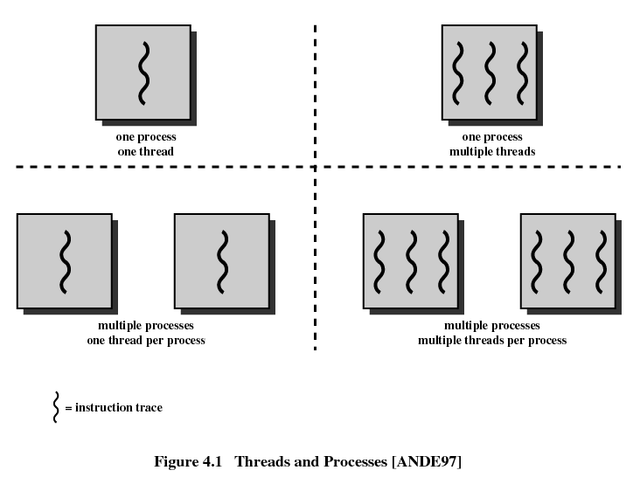

Slide 10
Process ——Unit of Resource allocation and Unit of Protection(资源分配和保护的单位)
Have a virtual address space(虚拟地址空间) which holds the process image( code, data, stack and PCB进程控制块)
Protected access to processors, memory, other processes(与其他进程通信), files, and I/O resources
Contains one or more threads
Notes:
Protected access 受保护访问

Slide 11
Thread —— Unit of Scheduling/Execution(调度执行的单位)
Each thread has:
  An execution state (running, ready, etc.)
  Saved thread context when not running
  Has an execution stack
  Some per-thread static storage for local variables 局部变量存储空间
  Access to the memory and resources of its process
    all threads of a process share this

Slide 12
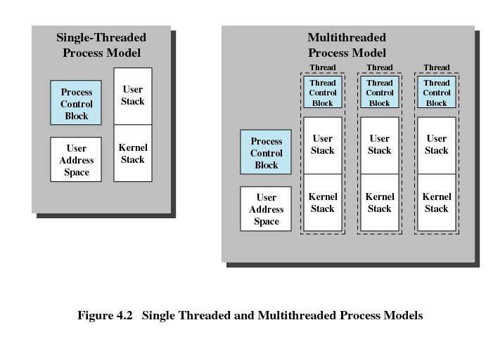
Distinction Between Threads and Processes From the Point of View of Process Management (从进程管理的角度看线程和进程)

Slide 13
Benefits(优点) of Threads
Takes less time to create a new thread than a process (创建快)
Less time to terminate a thread than a process (结束快)
Less time to switch between two threads within the same process (切换快)
Since threads within the same process share memory and files, they can communicate with each other without invoking the kernel (通信快)

Slide 14
Threads are Affected by Many Process Action
Suspending a process involves suspending all threads of the process since all threads share the same address space (挂起进程会挂起该进程的所有线程)
Termination of a process, terminates all threads within the process (终止进程会终止该进程的所有线程)

Slide 15
4.1 Processes and Threads
4.1.1 Introduction
4.1.2 Multithreading
4.1.3 Thread Functionality (线程功能特性)
4.1.4 User-Level and Kernel-Level Thread
4.1.5 Other Arrangements
Notes:
线程具有执行状态，且可以与另外一个线程同步。线程的同步与进程同步相同，在以后的章节中讲解

Slide 16
Thread States
Operations associated with a change in thread state
  Spawn(派生)
    Spawn another thread
  Block(阻塞)
  Unblock(解除阻塞)
  Finish
    Deallocate register context and stacks

Slide 17
Thread States
Suspending a process involves suspending all threads of the process
Blocking a thread involves blocking the process，right？

Slide 18
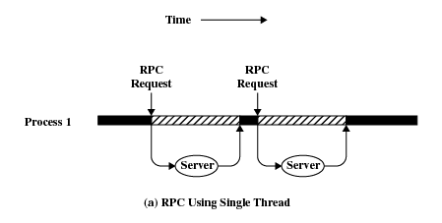
Remote Procedure Call Using Single Thread

Slide 19
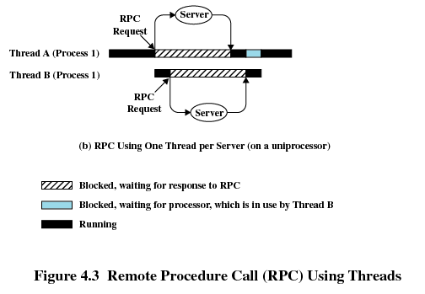
Remote Procedure Call Using Threads

Slide 20
4.1 Processes and Threads
4.1.1 Introduction
4.1.2 Multithreading
4.1.3 Thread Functionality
4.1.4 User-Level and Kernel-Level Thread
4.1.5 Other Arrangements

Slide 21
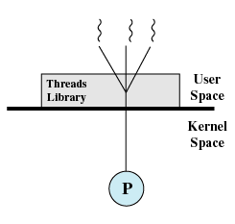
User-Level Threads (ULT，用户级线程)
Multithread implemented by a threads library
All thread management is done by the application
The kernel is not aware of the existence of threads & scheduling is done on a process basis

Slide 22
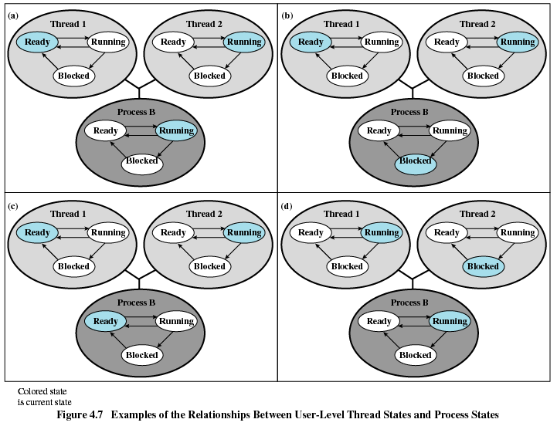
Notes:
The figure shows the relationship between thread scheduling and process scheduling.
1、Thread 2 makes a system call that blocks Process B. According to the data structure maintained by the threads library, thread 2 is still in the Running state. Figure (a) and (b).
2、Process B exhausts its time slice and the kernel places Process B in the Ready state. Meanwhile, according to the data structure maintained by the threads library, thread 2 is sting in the Running state. Figure(c)
3、Thread 2 has reached a point where it needs some action performed by thread 1. Thread 2 enters a Blocked state and thread 1 transitions from Ready to Running. Process B remains in the Running state. Figure (d)
A process that implements multithread using thread library may be in the midst of a thread switch from one thread to another when interrupted.

Slide 23
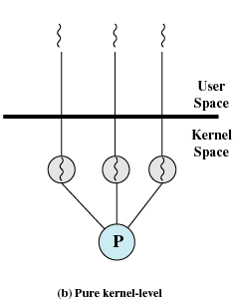
Kernel-Level Threads(内核级线程)
Kernel maintains context information for the process and the threads
Scheduling is done on a thread basis

Slide 24
Advantages of ULT to KLT
Less overhead更少的代价 of thread switches(mode switches do not required)
Scheduling can be application specific
ULTs can run on any operating system
Notes:
Less overhead 更少的代价

Slide 25
Disadvantages of ULT to KLT
One thread is blocked, all other threads of the process are blocked
A multithreaded application cannot take advantage of multiprocessing
Ways to work around these drawbacks:
  Multiple processes 多进程
  Jacketing套管 非阻塞调用
Notes:
非阻塞的系统调用

Slide 26
Advantages of KLT to ULT
Overcomes the two principal drawbacks of the ULT
  Multiple threads in one process can simultaneously run on multiple processors
  One threads blocked cannot make the other threads within the same process blocked
  Kernel routines例程 themselves can be multithreaded

Slide 27
Disadvantages of KLT to ULT
The principal disadvantage is that thread switch requires mode switches(模式切换) to the kernel

Slide 28
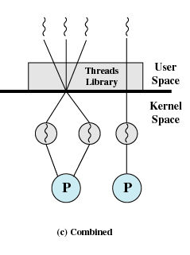
Combined Approaches
Example is Solaris
Thread creation done in the user space
The multiple ULTs from a single application are mapped onto some (smaller or equal) number of KLTs
Bulk of scheduling and synchronization大量的调度和同步of threads within application
Notes:
大量的调度和同步，在进程内进行

Slide 29
4.1 Processes and Threads
4.1.1 Introduction
4.1.2 Multithreading
4.1.3 Thread Functionality
4.1.4 User-Level and Kernel-Level Thread
4.1.5 Other Arrangements方案

Slide 30
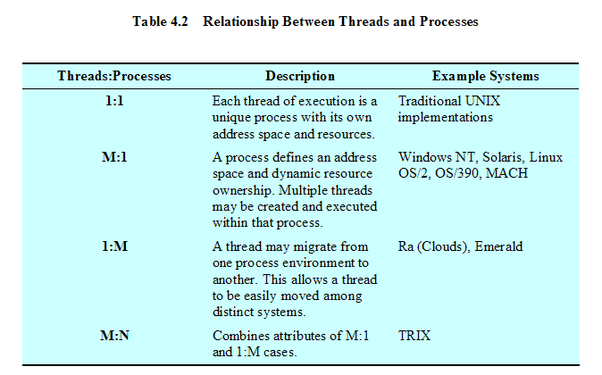
Relationship Between Threads and Processes

Slide 31
Agenda
4.1 Processes and Threads
4.2 Symmetric均衡 Multiprocessing
4.3 Microkernel
4.4 Summary

Slide 32
4.2 Symmetric Multiprocessing
4.2.1 SMP Architecture
4.2.2 SMP Organization
4.2.3 Multiprocessor Operating System Design
Considerations

Slide 33
Categories of Computer Systems
Single Instruction Single Data (SISD) stream(单指令单数据流)
  Single processor executes a single instruction stream to operate on data stored in a single memory
Single Instruction Multiple Data (SIMD) stream(单指令多数据流)
  A single instruction controls the simultaneous execution of a number of processing elements on a lockstep basis. Each instruction is executed on a different set of data by the different processors
  E.g. vector and array processors

Slide 34
Categories of Computer Systems
Multiple Instruction Single Data (MISD) stream(多指令单数据流)
  A sequence of data is transmitted to a set of processors, each of which executes a different instruction sequence. Never implemented
Multiple Instruction Multiple Data (MIMD) stream (多指令多数据流)
  A set of processors simultaneously execute different instruction sequences on different data sets

Slide 35
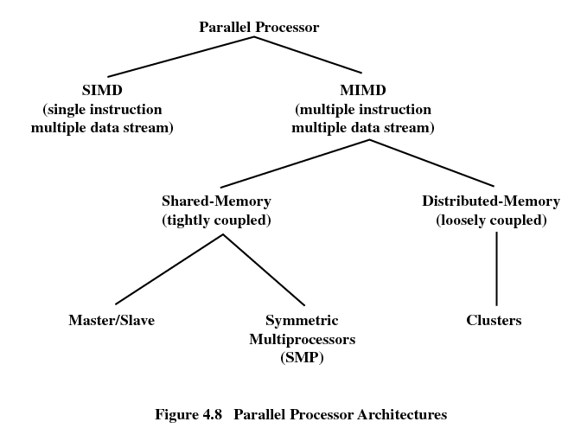

Slide 36
Symmetric Multiprocessing
Kernel can execute on any processor
Typically each processor does self-scheduling form the pool of available process or threads自己调度形成可用的进程或线程池
Notes:
自己调度形成可用的进程或线程池

Slide 37
4.2 Symmetric Multiprocessing
4.2.1 SMP Architecture
4.2.2 SMP Organization
4.2.3 Multiprocessor Operating System Design
Considerations

Slide 38
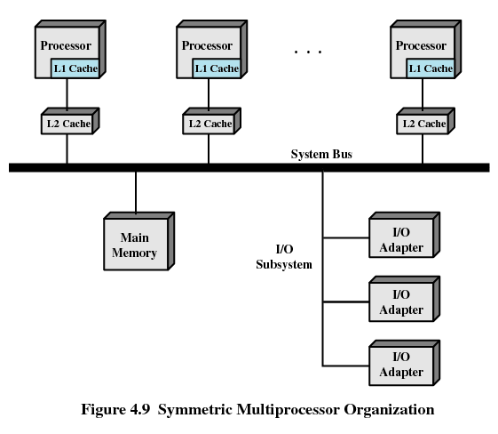

Slide 39
4.2 Symmetric Multiprocessing
4.2.1 SMP Architecture
4.2.2 SMP Organization
4.2.3 Multiprocessor Operating System Design
Considerations

Slide 40
Multiprocessor Operating System Design Considerations
Simultaneous(同时) concurrent(并发) processes or threads (内核例程要求可重入reentrant，避免死锁)
Scheduling
Synchronization(同步)
Memory management
Reliability(可靠性) and fault tolerance(容错)

Slide 41
Agenda
4.1 Processes and Threads
4.2 Symmetric Multiprocessing
4.3 Microkernel
4.4 Summary

Slide 42
4.3 Microkernel(微内核)
4.3.1 Microkernel Architecture
4.3.2 Benefits of a Microkernel Organization
4.3.3 Microkernel Performance
4.3.4 Microkernel Design

Slide 43
Microkernel
Small operating system core
Contains only essential core operating systems functions
Many services traditionally included in the operating system are now external subsystems
  Device drivers
  File systems
  Virtual memory manager
  Windowing system
  Security services
相对的内核称为单体内核—monolithic kernel

Slide 44
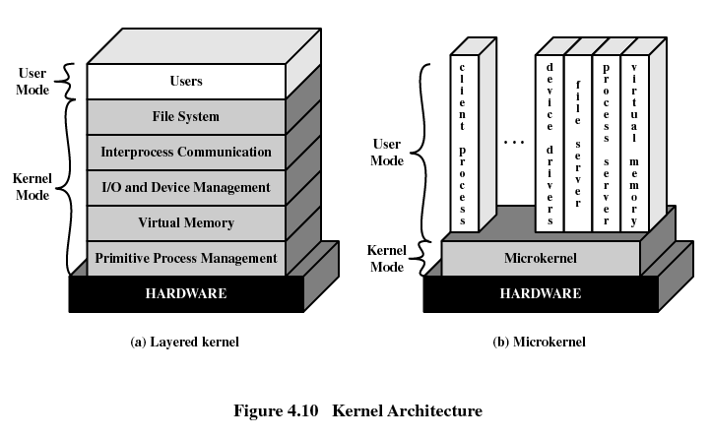

Slide 45
4.3 Microkernel
4.3.1 Microkernel Architecture
4.3.2 Benefits of a Microkernel Organization
4.3.3 Microkernel Performance
4.3.4 Microkernel Design

Slide 46
Benefits of a Microkernel Organization
Uniform interface(一致接口) on request made by a process
  Don’t distinguish between kernel-level and user-level services
  All services are provided by means of message passing
Extensibility(可扩展性)
  Allows the addition of new services
Flexibility(灵活性)
  New features added
  Existing features can be subtracted(删减)
Notes:
means of message passing
消息传递手段

Slide 47
Benefits of a Microkernel Organization
Portability(可移植性)
  Changes needed to port the system to a new processor is changed in the microkernel - not in the other services
Reliability(可靠性)
  Modular design
  Small microkernel can be rigorously tested

Slide 48
Benefits of a Microkernel Organization
Distributed system support
  Message are sent without knowing what the target machine is （消息的发送不用关心目标是本机还是异机）
Object-oriented operating system
  Components are objects with clearly defined interfaces that can be interconnected to form software (定义接口明晰的组件，以搭积木方式通过组件互联构造软件)

Slide 49
4.3 Microkernel
4.3.1 Microkernel Architecture
4.3.2 Benefits of a Microkernel Organization
4.3.3 Microkernel Performance
4.3.4 Microkernel Design

Slide 50
4.3.3 Microkernel Performance
A potential disadvantage of microkernels that is often cited is that of performance (消息传递机制是微内核工作的主要机制，消息传递必须通过内核，因此性能较差)
One response to this problem was to enlarge the microkernel by reintegrating critical servers and drivers back into the OS (把关键服务重新纳入内核，减少消息传递开销)

Slide 51
4.3 Microkernel
4.3.1 Microkernel Architecture
4.3.2 Benefits of a Microkernel Organization
4.3.3 Microkernel Performance
4.3.4 Microkernel Design

Slide 52
Microkernel Design
The microkernel must include those functions that depend directly on the hardware. Those functions fall into the following general categories:
Low level memory management
Interprocess communication (IPC)
I/O and interrupt management

Slide 53
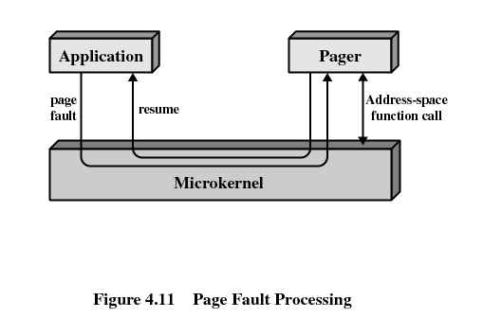
Microkernel Design
Low-level memory management
  Mapping each virtual page to a physical page frame

Slide 54
Microkernel Design
Interprocess communication
  Message
  Port

Slide 55
Microkernel Design
I/O and interrupt management
  The microkernel transforms interrupts into messages and dispatches messages to device-specific user-level interrupt handling.
  Driver thread:
  do
  waitFor (msg, sender);
  if (sender == my_hardware_interrupt)
  {
  read/write I/O ports;
  reset hardware interrupt
  }
  else …
  while (true);

Slide 56
Agenda
4.1 Processes and Threads
4.2 Symmetric Multiprocessing
4.3 Microkernel
4.4 Summary

